Slide 1
Vali IT
Authorization

Slide 2
Lisa pom.xml-i
<dependency> <groupId>org.springframework.boot</groupId> <artifactId>spring-boot-starter-security</artifactId> </dependency>
<dependency> <groupId>io.jsonwebtoken</groupId> <artifactId>jjwt</artifactId> <version>0.9.1</version> </dependency>

Slide 3

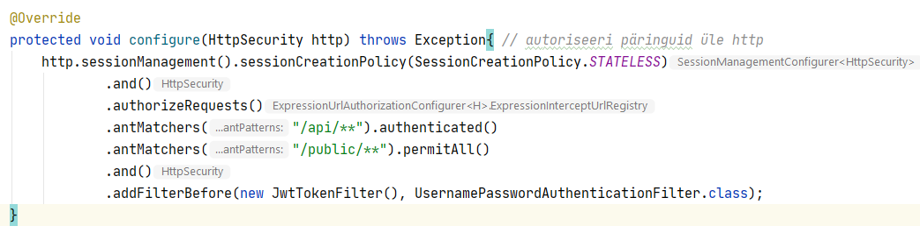
Update security config

Slide 4
Loo konto loomis teenus ja sisselogimis teenus
Loo REST endpoint, mis võtab sisse kasutajanime ja parooli.
Korrektsete andmete puhul tagasta token

Slide 5
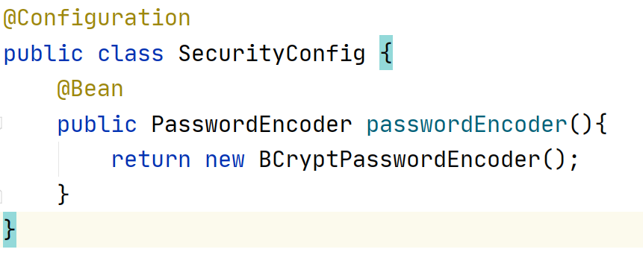
Defineeri PasswordEncode

Slide 6
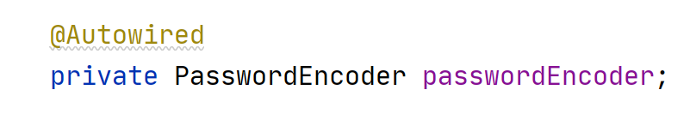
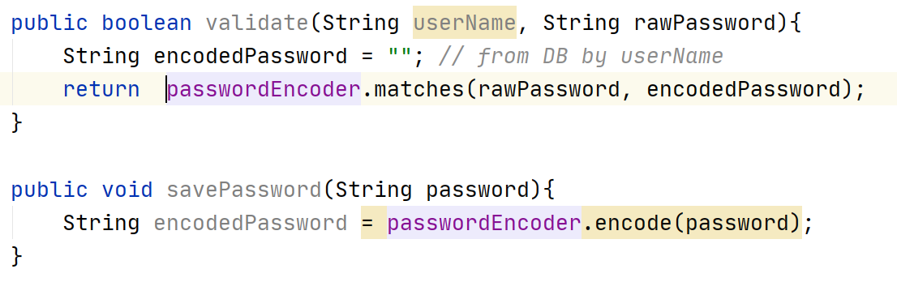
Parooli valideerimine
Lisa Password Encoder sinna kus sa tahad parooli hashi genereerida või valideerida

Slide 7
Tokeni genereerimine – service kihti
JwtBuilder builder = Jwts.builder() .setExpiration(tokenExpiryDate) .setIssuedAt(new Date()) .setIssuer("issuer") .signWith(SignatureAlgorithm.HS256, "secret")
.claim(„username", userName); String jwt = builder.compact();

Slide 8
Store token in localstorage
localStorage.setItem('user-token', token) // store the token
this.$http.defaults.headers.common['Authorization’] = „Bearer „ + token
localStorage.removeItem('user-token') // remove on logout
In main.js add:
const token = localStorage.getItem('user-token’)
if (token) {
axios.defaults.headers.common['Authorization']=„Bearer „+ token
}

Slide 9
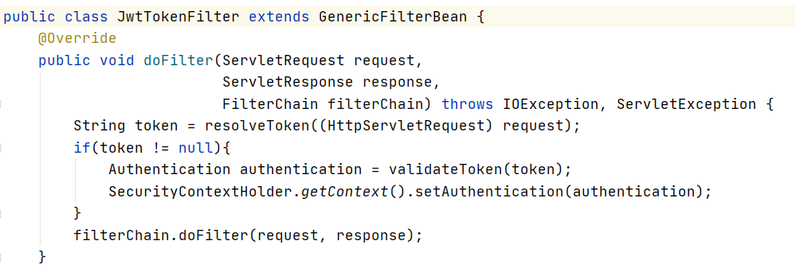
Add filter
Create JWT filter

Slide 10
Implement resolve token
String resolveToken(HttpServletRequest req) { String headerAttribute = req.getHeader("Authorization"); if (headerAttribute == null) { return null; } if (headerAttribute.startsWith("Bearer ")) { return headerAttribute.substring(7); } return headerAttribute; }

Slide 11
Implement validate token method
Authentication validateToken(String token) { Claims claims = Jwts.parser().setSigningKey("secret").parseClaimsJws(token).getBody(); List<GrantedAuthority> grantedAuthorityList = new ArrayList<GrantedAuthority>(); grantedAuthorityList.add(new SimpleGrantedAuthority("ROLE_USER")); UserDetails userDetails = new User((String)claims.get("username"),"", grantedAuthorityList); return new UsernamePasswordAuthenticationToken(userDetails, "", userDetails.getAuthorities()); }

